Slide 1
Disorders of the spinal cord - 1

Slide 2
Where is the lesion?
What is the lesion?

Slide 3
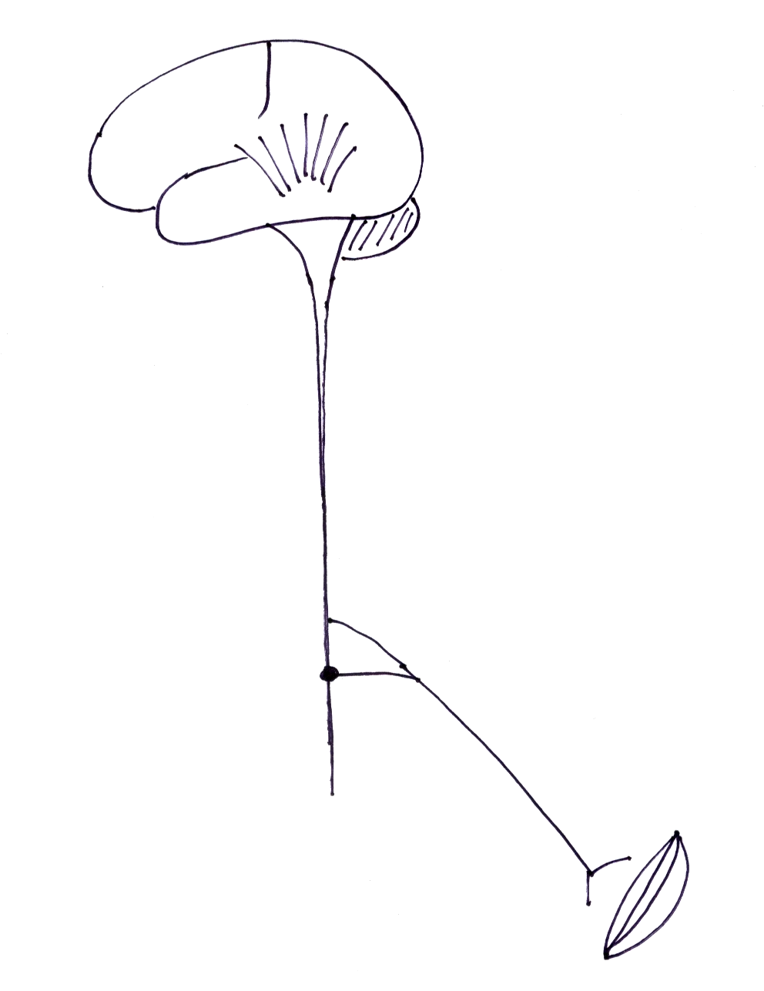
Where is the lesion?
spinal
cord

Slide 4
Where is the lesion?
localization - vertical plane
horizontal plane

Slide 5
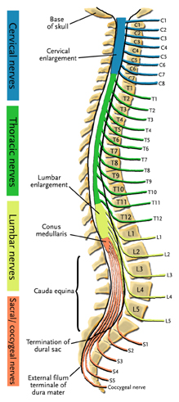
localization in the VERTICAL plane
  vertebral level spinal root level
  C 1-7 cervical C 1-8
  T 1-9 thoracic T 1-12
  T 9-11 lumbar L 1-5
  T 12- L1 sacral S 1-5

Slide 6
localization in the VERTICAL plane
  motor level
  sensory level
  reflex level

Slide 7
Where is the lesion?
localization in the HORIZONTAL plane

Slide 8
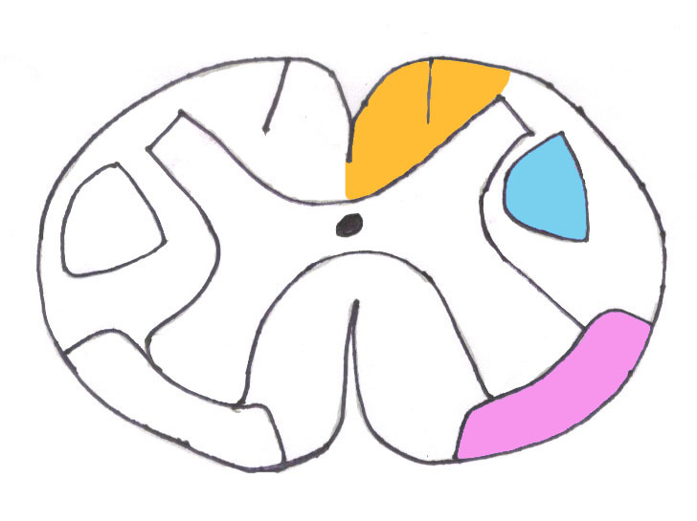
posterior columns
corticospinal tract
spinothalamic tract

Slide 9
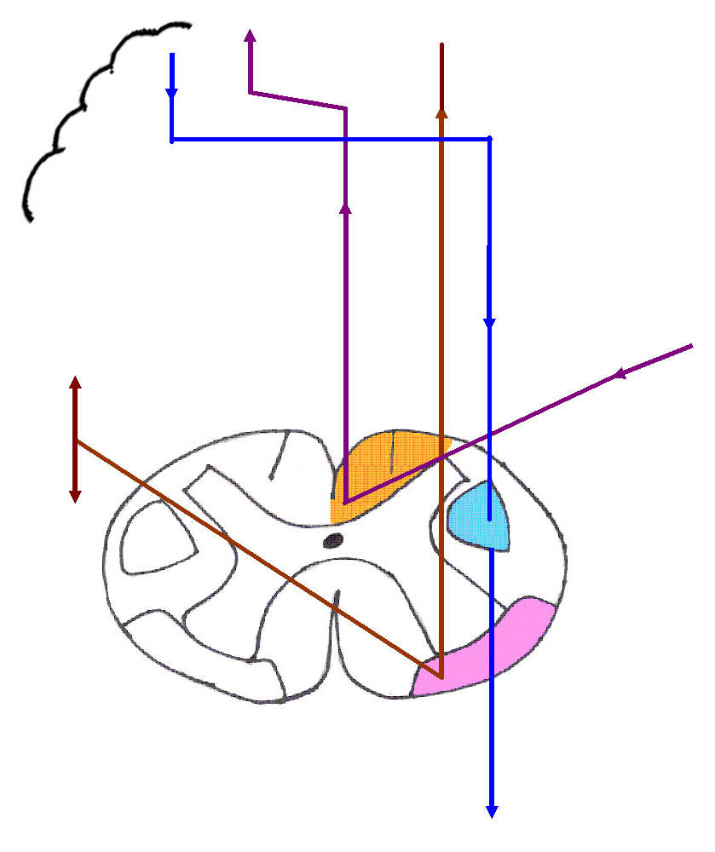

Slide 10
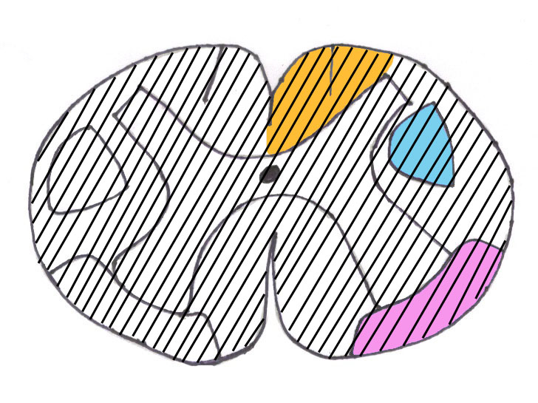
complete cord syndrome- transection

Slide 11
complete cord syndrome- transection
below level of lesion -
motor - UMN weakness
sensory loss - below lesion - sensory level
  spinothalamic
  posterior columns
bladder dysfunction
at level of lesion -
LMN signs
dermatomal sensory loss
root pain

Slide 12
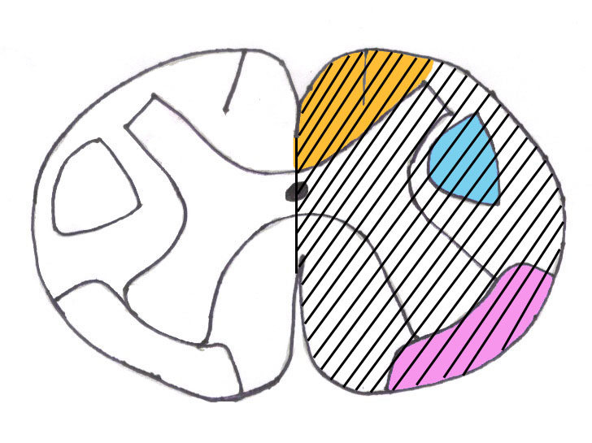
hemi-cord syndrome (Brown-Sequard)

Slide 13

hemi-cord syndrome (Brown-Sequard)

Slide 14
hemi-cord syndrome (Brown-Sequard)
below level of lesion -
ipsilateral UMN weakness
ipsilateral posterior column sensory loss - numbness
contralateral spinothalamic loss – hemi-sensory level - painful dysaesthesia
at level of lesion -
LMN signs
root pain
dermatomal sensory loss

Slide 15
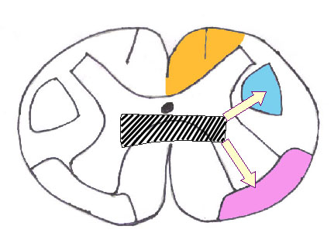
central cord syndrome

Slide 16
central cord syndrome
1st – segmental signs - at level of lesion
crossing spinothalamic fibres – loss of pain, temp
AHC – LMN signs
2nd – long tract signs - below level of lesion
spinothalamic fibres – descending loss of pain, temp – ‘cape’
sacral sparing
post. columns intact
dissociated sensory loss
pyramidal tracts - UMN signs
Horner’s

Slide 17
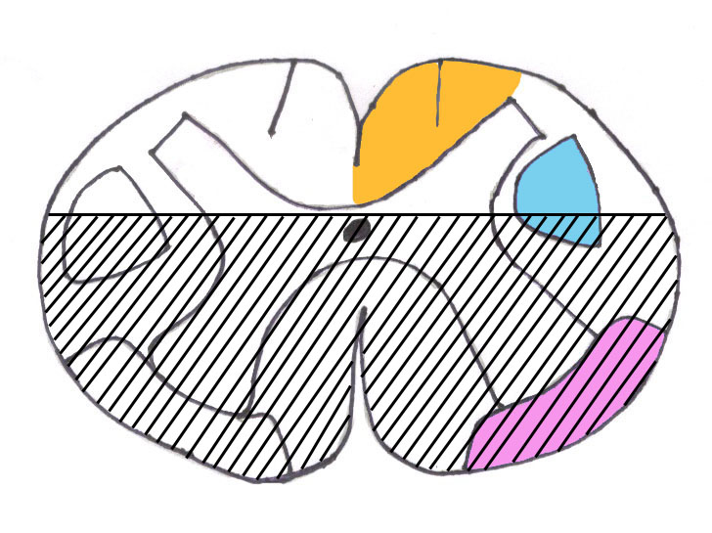
anterior cord syndrome

Slide 18
anterior cord syndrome
below level of lesion -
UMN weakness
sensory level
  spinothalamic
bladder dysfunction
posterior columns not involved
anterior spinal A. occlusion

Slide 19
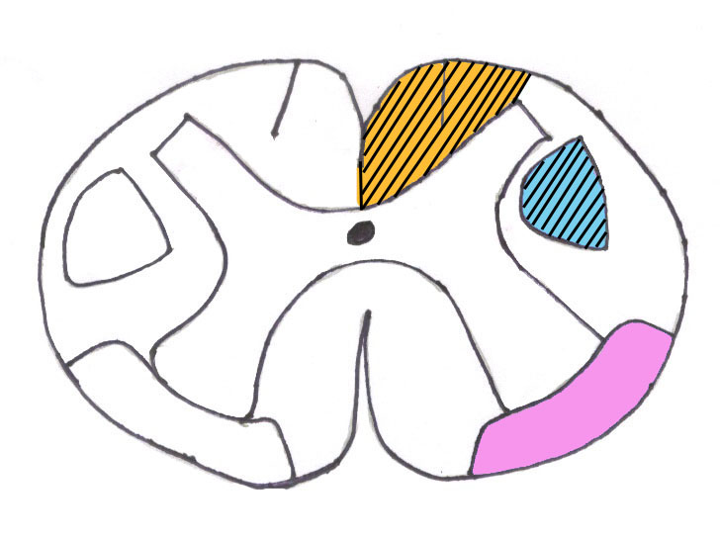
subacute combined degeneration of the cord
B12 deficiency
post columns and pyramidal tracts
ass. with B12 polyneuropathy

Slide 20
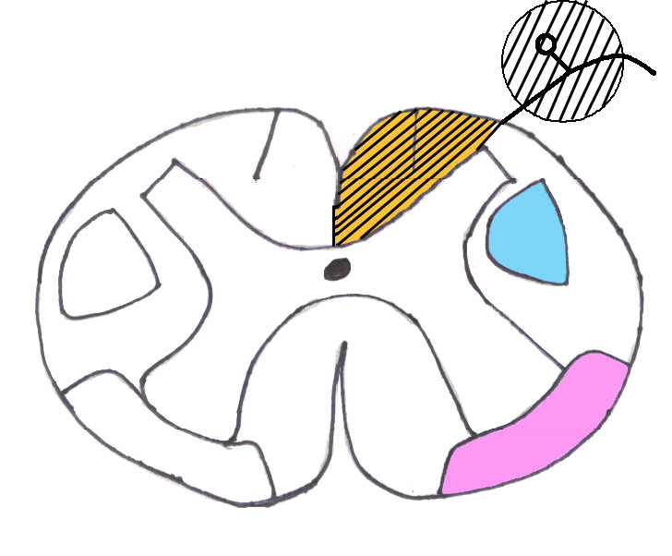
tabes dorsalis
neurosyphilis
post columns and dorsal root ganglia
radicular pain - ‘tabetic crises’

Slide 21
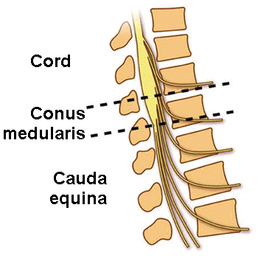
Cauda equina lesions

Slide 22
Cauda equina lesions
Conus medullaris lesion
High cauda equina (Conus/ Cauda) lesion
Low cauda equina lesion
variable signs

Slide 23
Cauda equina lesions
lower lumbar/ sacral roots
pain - thigh, buttocks, perineum
leg weakness, wasting
KJ, AJ - variable
saddle anaesthesia
sphincter disturbance - bladder, bowel
sexual dysfunction

Slide 24
Remember!
‘spinal shock’ -
  early stages of acute cord lesions
  flaccid areflexic paralysis with sensory loss and bladder dysfunction
bladder involvement -
  with bilateral cord involvement
  1st - urgency, retention; then incontinence
  early in cauda equina lesions
‘flexor spasms’ -
  in late stages

Slide 25
Disorders of the spinal cord - 2

Slide 26
What is the lesion?

Slide 27
What is the lesion?
depends on
  where is the lesion
  temporal profile
  other clues to aetiology

Slide 28
What is the lesion?
 | acute | subacute/ chronic
complete | trauma | transverse myelitis, tumour
hemi-cord | trauma | tumour
anterior | anterior spinal A. occlusion | vertebral collapse, disc lesion
central | trauma - haematomyelia | syrinx, intramedullary tumour

Slide 29
What is the lesion?
compressive
non-compressive myelopathy

Slide 30
What is the lesion?
compressive
non-compressive myelopathy
Every cord lesion is compressive, until proven otherwise!

Slide 31
What is the lesion?
compressive
  tumours - I^{ry}, II^{ry},
  vertebral collapse
  disc lesion
  abscess
non-compressive myelopathy
  inflammation – trans. myelitis, MS, conn. tis. dis.
  infection – TB, viral, HIV
  vascular – ant. spinal A. occlusion, haemorrhage
  metabolic – B12 def.
  degenerative – syrinx, MND

Slide 32
extra-medullary, extra-dural
  vertebral collpase -TB, tumours
  disc lesions
  epidural abscess
extra-medullary, intra-dural
  meningioma, neurofibroma
intra-medullary
  intramedullary tumours
  syrinx

Slide 33
Investigations
demonstrate spinal cord disease
look for cause

Slide 34
Investigations
demonstrate spinal cord disease
  X-ray – vertebral collapse, pedicle erosion
  MRI – compressive, non-compressive
  myelography
look for cause
  CSF
  other -

Slide 35


Slide 36
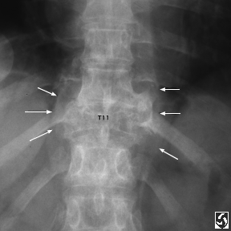

Slide 37
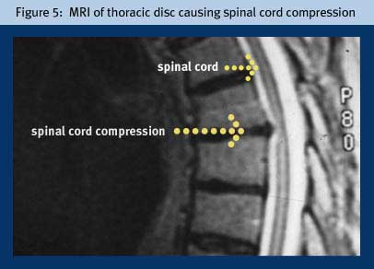

Slide 38
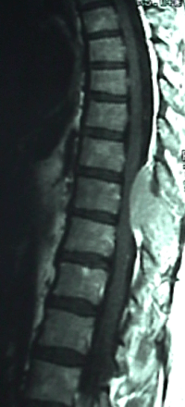

Slide 39
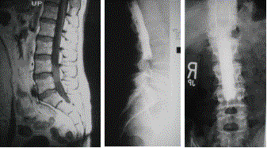
myelogram – extradural compression at L45

Slide 40
Treatment
treat spinal cord disease
treat cause

Slide 41
Treatment
treat spinal cord disease
  iv steroids – methyl prednisolone, dexamethasone,
  rehabilitation
  Rx spasticity - baclofen, tizanidine
  Rx bladder problems
  surgery
treat cause – specific treatment

